Slide 1
Continuous Random Variables and Probability Distributions

Slide 2
LO
Describe the probability distribution and calculate the mean and variance of a continuous random variable
Continuous Uniform Distribution
Normal Random Variable
Exponential Distribution

Slide 3
Continuous Random Variables
connection speed
length
or size
Continuous variables can take any value of an interval in 
Continuous
r. v.
examples
physical measurements
height
or weight
durations of time
reaction time
lifetime
waiting time

Slide 4
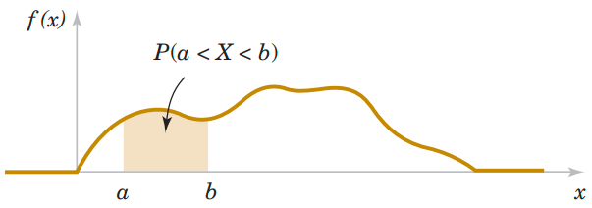
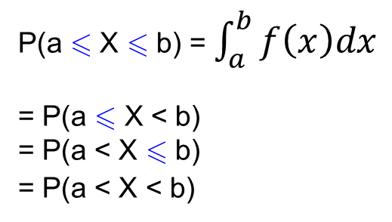
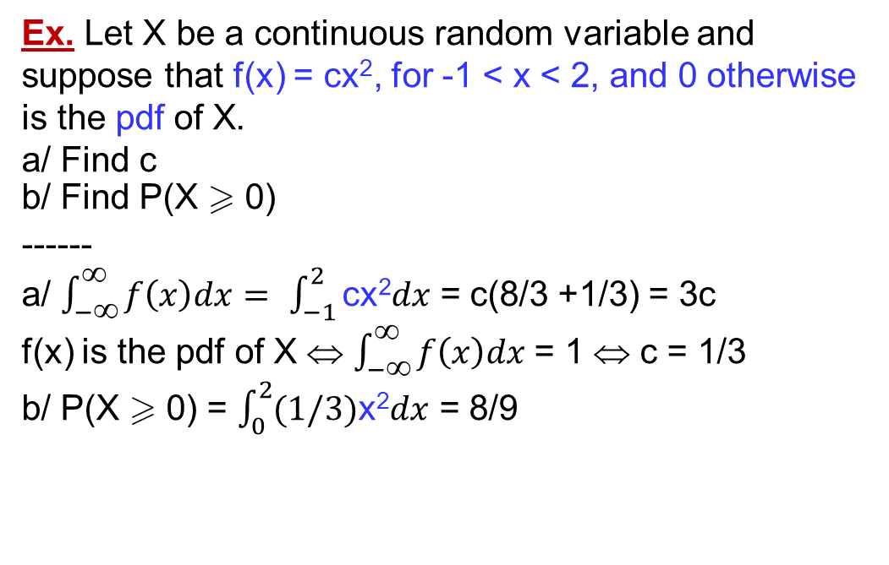
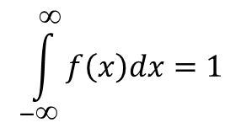
Probability Density Function (pdf)
“density” is a measure of “probability mass” per unit length
f(x)  0
pdf f(x)
$$\int_{−∞}^{∞}{f\left(x\right)dx}=1$$
Probability determined from the area under f(x).
Ex. Let X be a continuous random variable and suppose that f(x) = cx², for -1 < x < 2, and 0 otherwise is the pdf of X.
a/ Find c
b/ Find P(X  0)
------
a/ $\int_{−∞}^{∞}{f\left(x\right)dx}=$ $\int_{−1}^{2}{\text{cx}\text{2}dx}$ = c(8/3 +1/3) = 3c
f(x) is the pdf of X ⇔ $\int_{−∞}^{∞}{f\left(x\right)dx}$= 1 ⇔ c = 1/3
b/ P(X  0) = $\int_{0}^{2}{(1/3)\text{x}\text{2}dx}$ = 8/9
P(a  X  b) = $\int_{a}^{b}{f\left(x\right)dx}$
= P(a  X < b)
= P(a < X  b)
= P(a < X < b)
P(X = x₀) = 0
(different from pmf)

Slide 5
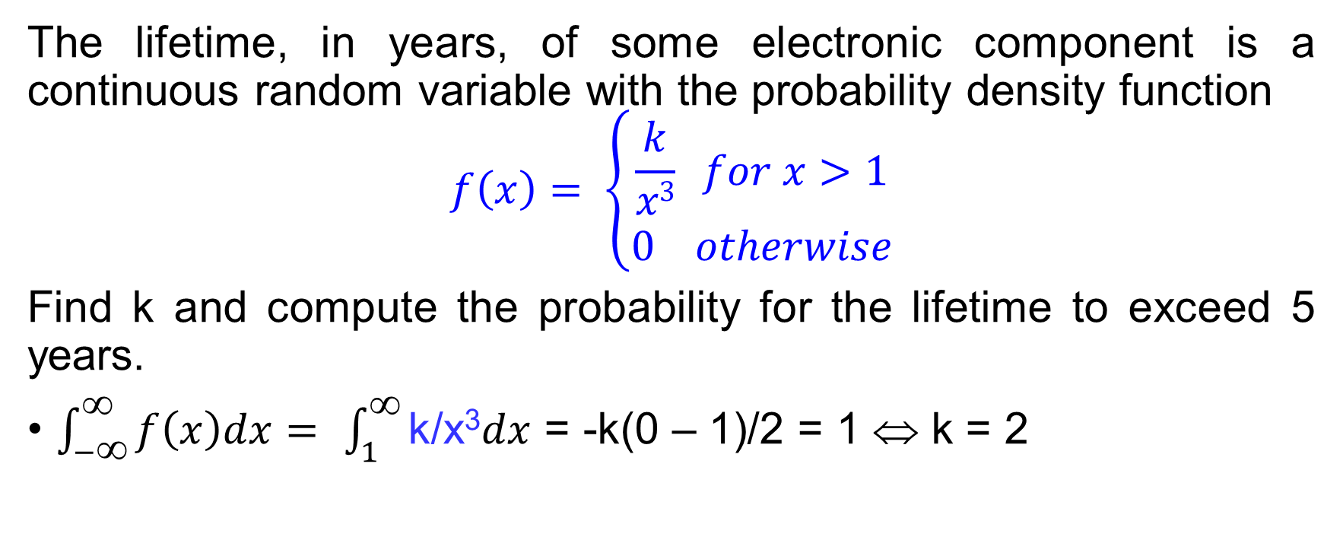
Probability Density Function Pdf – Ex
The lifetime, in years, of some electronic component is a continuous random variable with the probability density function
$$f\left(x\right)= \left\{\begin{aligned}\frac{k}{x3} for x>1 \\ 0 otherwise\end{aligned}\right.$$
Find k and compute the probability for the lifetime to exceed 5 years.
$\int_{−∞}^{∞}{f\left(x\right)dx}=$ $\int_{1}^{∞}{\text{k}\text{/}\text{x}\text{3}dx}$ = -k(0 – 1)/2 = 1 ⇔ k = 2

Slide 6
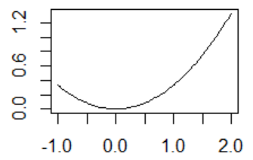
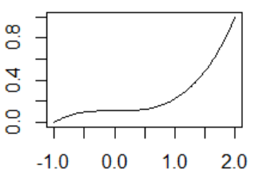
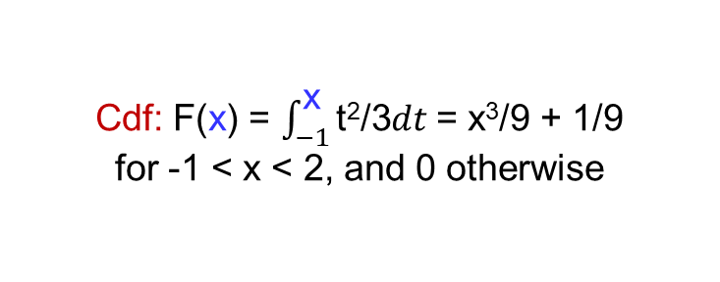
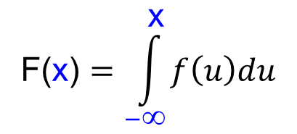

Cumulative Distribution Function (cdf)
F(x) = P(X  x)
= P(X < x)
$\text{F}\text{′}\text{(}\text{x}\text{)}=$ f(x)
cdf F(x)
$$\text{F}\text{(}\text{x}\text{)}=\int_{−∞}^{\text{x}}{f\left(u\right)du}$$
P(a  X  b)
= F(b) – F(a)
Pdf: f(x) = x²/3, for -1 < x < 2
F(x)  F(y)
if x  y
(increasing)
lim_{x→ -∞} F(x) = 0
lim_{x→ ∞} F(x) = 1
Cdf: F(x) = $\int_{−1}^{\text{x}}{\text{t}\text{2}\text{/3}dt}$= x³/9 + 1/9
for -1 < x < 2, and 0 otherwise
Notes:
f<-function(x) x^2/3
plot(f,xlim=c(-1,2),lwd=2)
F<-function(x) x^3/9+1/9
plot(F,xlim=c(-1,2),lwd=2)

Slide 7
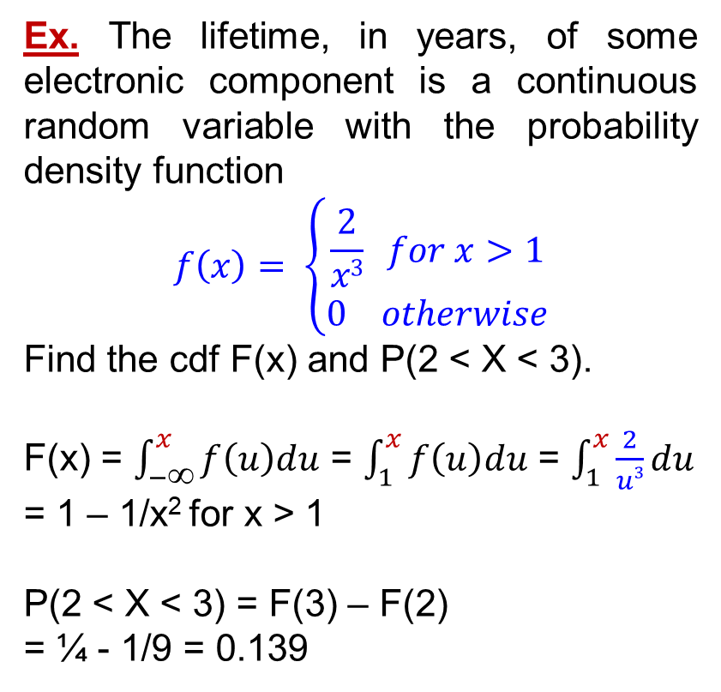
Pdf vs Cdf – Ex
Ex. The lifetime, in years, of some electronic component is a continuous random variable with the probability density function
$$f\left(x\right)= \left\{\begin{aligned}\frac{2}{x3} for x>1 \\ 0 otherwise\end{aligned}\right.$$
Find the cdf F(x) and P(2 < X < 3).
F(x) = $\int_{−∞}^{x}{f\left(u\right)du}$ = $\int_{1}^{x}{f\left(u\right)du}$ = $\int_{1}^{x}{\frac{2}{u3}du}$
= 1 – 1/x² for x > 1
P(2 < X < 3) = F(3) – F(2)
= ¼ - 1/9 = 0.139
F(x) = P(X  x)
= P(X < x)
$\text{F}\text{′}\text{(}\text{x}\text{)}=$ f(x)
cdf F(x)
$$\text{F}\text{(}\text{x}\text{)}=\int_{−∞}^{\text{x}}{f\left(u\right)du}$$
P(a  X  b)
= F(b) – F(a)
F(x)  F(y)
if x  y
(increasing)
lim_{x→ -∞} F(x) = 0
lim_{x→ ∞} F(x) = 1

Slide 8
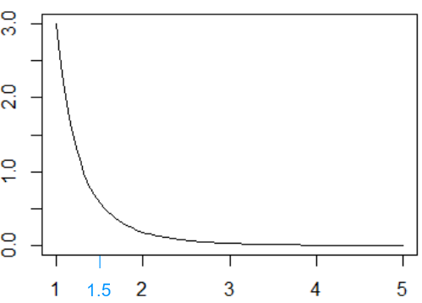
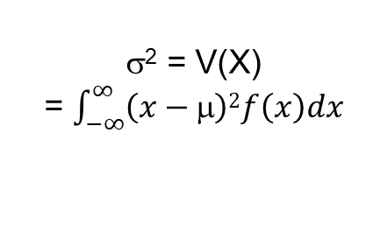
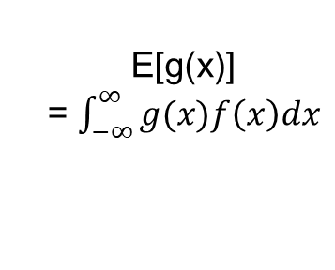
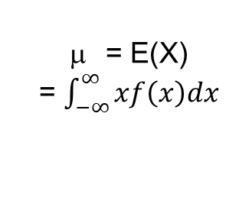
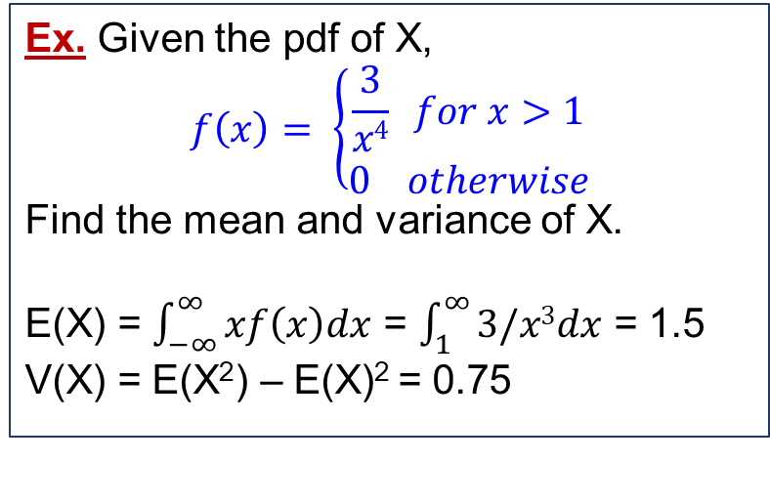

Mean and Variance
Expected
value of X
Measure central value
Expected
value of g(x)
Mean
μ
= E(X)
= $\int_{−∞}^{∞}{xf\left(x\right)dx}$
E[g(x)]
= $\int_{−∞}^{∞}{g(x)f\left(x\right)dx}$
Ex. Given the pdf of X,
$$f\left(x\right)= \left\{\begin{aligned}\frac{3}{x4} for x>1 \\ 0 otherwise\end{aligned}\right.$$
Find the mean and variance of X.
E(X) = $\int_{−∞}^{∞}{xf\left(x\right)dx}$ = $\int_{1}^{∞}{3/x3dx}$ = 1.5
V(X) = E(X²) – E(X)² = 0.75
X
Standard deviation
σ
Variance
σ²
σ² = V(X)
= $\int_{−∞}^{∞}{\left(x−\text{μ}\right)2f\left(x\right)dx}$
σ = $\sqrt{\text{σ}\text{2} }$
σ² = E(X²) – E(X)²
Measure spread of values

Slide 9
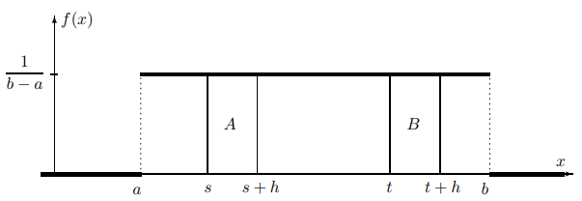
Continuous Uniform Distribution
used for computer simulation of various events and processes
used in any situation when a value is picked “at random” from a given interval
i.e., locations of errors in a program, birthdays throughout a year
Variance:
σ² = (b – a)²/12
Uniform Distribution
pdf:
f(x) = 1/(b-a)
For h > 0,
P(t < X < t + h) = h/(b-a)
is independent of t
Mean:
μ = (a + b)/2
Ex. Tri is taking a bus from Dist.1 to Thu Duc city, a distance of 15km. His position is uniformly distributed between the two areas. What is the probability that he is past Saigon Bridge, which is 5km from Dist.1?
Let X be Tri’s location ➔ X ∼ Unif(0, 15) ➔ P(X > 5) = (5 < X < 15) = (15 – 5)/(15 – 0) = 2/3.
Notes:
The R commands for the continuous uniform distribution on (a, b) are
punif(x,a,b) # P(X ≤ x)
dunif(x,a,b) # f(x)
runif(n,a,b) # Simulates n random variables.
Default parameters are a = 0 and b = 1. To generate a uniform variable on (0, 1), type runif(1)

Slide 10
Continuous Uniform Distribution – Ex
(Uniform Current) Let the continuous random variable X denote the current measured in a thin copper wire in milliamperes. Assume that the range of X is [0, 20 mA], and assume that the probability density function of X is f(x) = 0.05, 0  x  20. Find P(5 < X < 10), E(X), V(X).
-----
P(5 < X < 10) = (10 – 5)(0.05) = 0.25
E(X) = (a + b)/2 = (0 + 20)/2 = 10
V(X) = (b – a)²/12 = (20 – 0)²/12 = 33.33

Slide 11
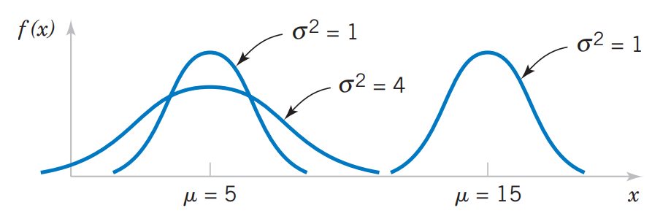
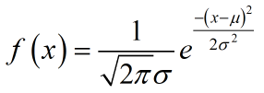
Normal Distribution (Gaussian distribution)
Plays a vital role in Probability and Statistics
Good model for physical variables like weight, height, temperature, voltage, pollution level (household incomes or student grades, etc.)
Normal
distribution
N(μ, σ²)
Related to the Central Limit Theorem (chapter 7)
Bell-shaped curve
Not easy to compute with paper and pencil
Normal probability density functions for selected values of μ and σ².
Notes:
dnorm(x, μ, σ)
pnorm(x, μ, σ)
rnorm(n, μ, σ)
Pdf
mu <- n*p
sigma <- (n*p*(1-p))^(1/2)
f <- function (x) (1/(sigma*(2*pi)^(1/2)))*exp(-(x-mu)^2/(2*sigma^2))

Slide 12
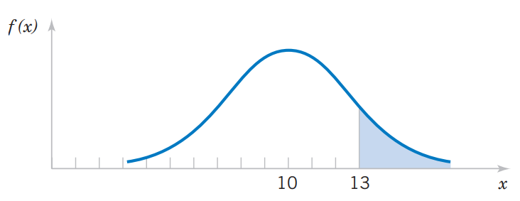
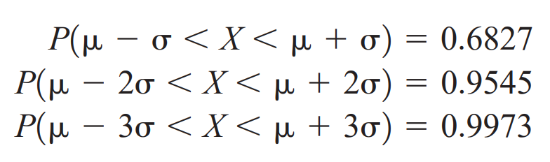
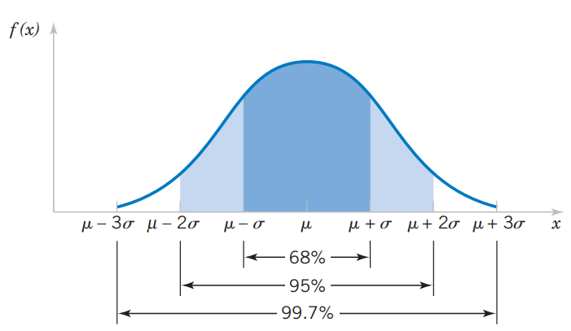
Normal Distribution
For any normal random variable
Probability that X > 13 for a normal random variable with and μ = 10 and σ² = 4.
6σ is often referred to as the width of a normal distribution.

Slide 13
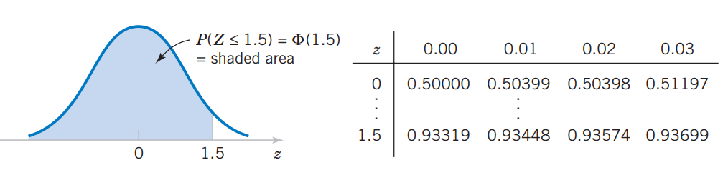
Standard Normal Random Variable
Standardize: If X ~ N(μ, σ²),
then Z = (X - μ)/σ ~ N(0, 1)
It is the key step to calculating a probability for an arbitrary normal random variable.
Standard
normal
distribution
Assume Z is a standard normal random variable. Appendix Table III provides probabilities of the form Φ(z) = P(Z  z). Read down the z column to the row that equals 1.5. The probability P(Z  1.5) is read from the adjacent column, labeled 0.00, to be 0.93319.
Z ~ N(0, 1)
Φ(z) = P(Z  z)
0.93319

Slide 14
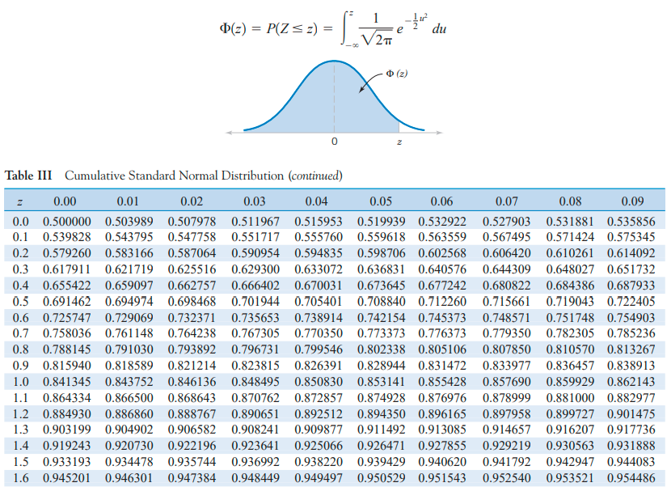
Φ(1.34) = P(Z  1.34) = 0.909877
Using Table III in the text book
to find probabilities of Normal distribution

Slide 15
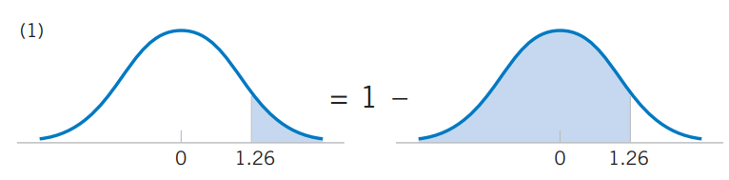

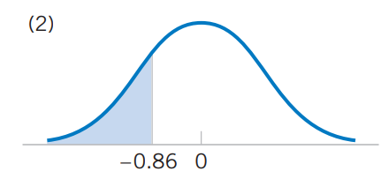
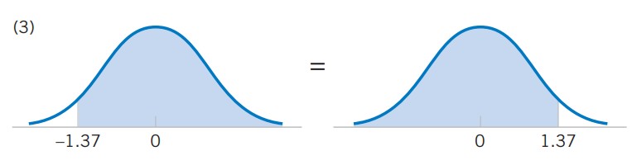


Slide 16
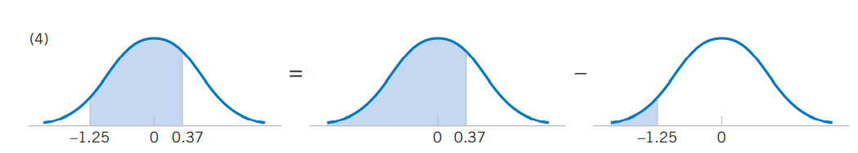
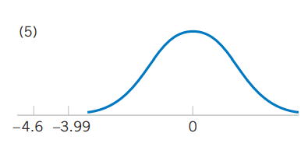
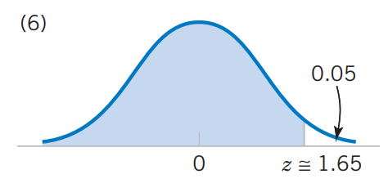
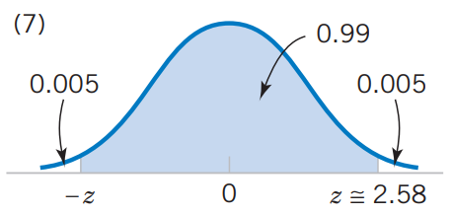
P(-1.25 < X < 0.37) = P(X < 0.37) – P(X < -1.25)
(6) Find z such that
P(Z > z) = 0.05.
Equivalently, find z such that
P(Z  z) = 0.95
(5) P(X < -4.6) cannot be found exactly from Appendix Table III. The last entry in the table can be used to find that P(X < -3.99) = 0.00003. So, 0 ≈ P(X < -4.6) < P(X < -3.99).
(7) Find z such that
P(-z < Z < z) = 0.99.
Find z such that
P(Z  z) = 0.995

Slide 17
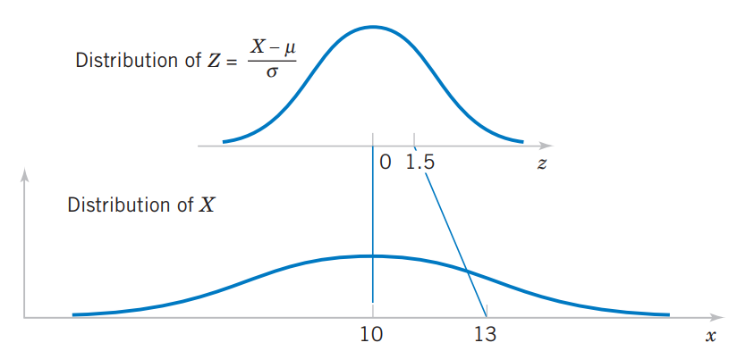
Standardizing a Normal Random Variable - Ex
Suppose the current measurements in a strip of wire are assumed to follow a normal distribution with a mean of 10 milliamperes and a variance of 4 (milliamperes)². What is the probability that a measurement will exceed 13 milliamperes?
Let X denote the current in milliamperes.
Let Z = (X - 10)/2.
Note that X >13 corresponds to Z >1.5.
Therefore, from Appendix Table III
P(X > 13) = P(Z > 1.5)
= 1 – P(Z 1.5) = 1- 0.93319 = 0.06681
Practical Interpretation: Probabilities for any normal random variable can be computed with a simple transform to a standard normal random variable.

Slide 18
Standardizing to Calculate a Probability
(Normally Distributed Current) Continuing the previous example.
a/ What is the probability that a current measurement is between 9 and 11 milliamperes?
b/ Determine the value for which the probability that a current measurement is below this value is 0.98.

Slide 19
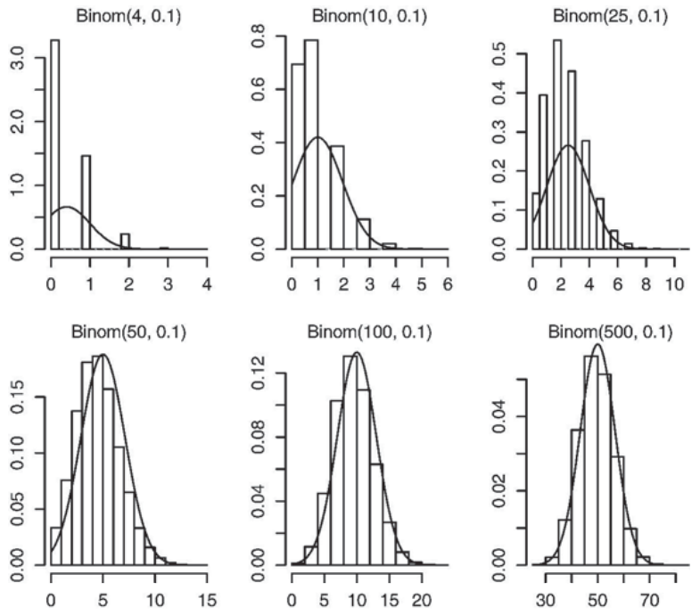
Normal Approximation to the Binomial Distribution
Binom(n, p)
~ N(μ = np, σ² = np(1-p))
Good approximation with n and p such that
np > 5, n(1 – p) > 5

Slide 20
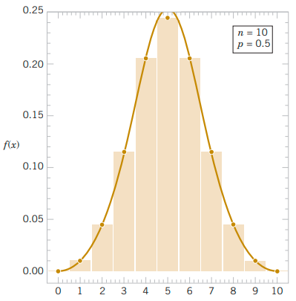
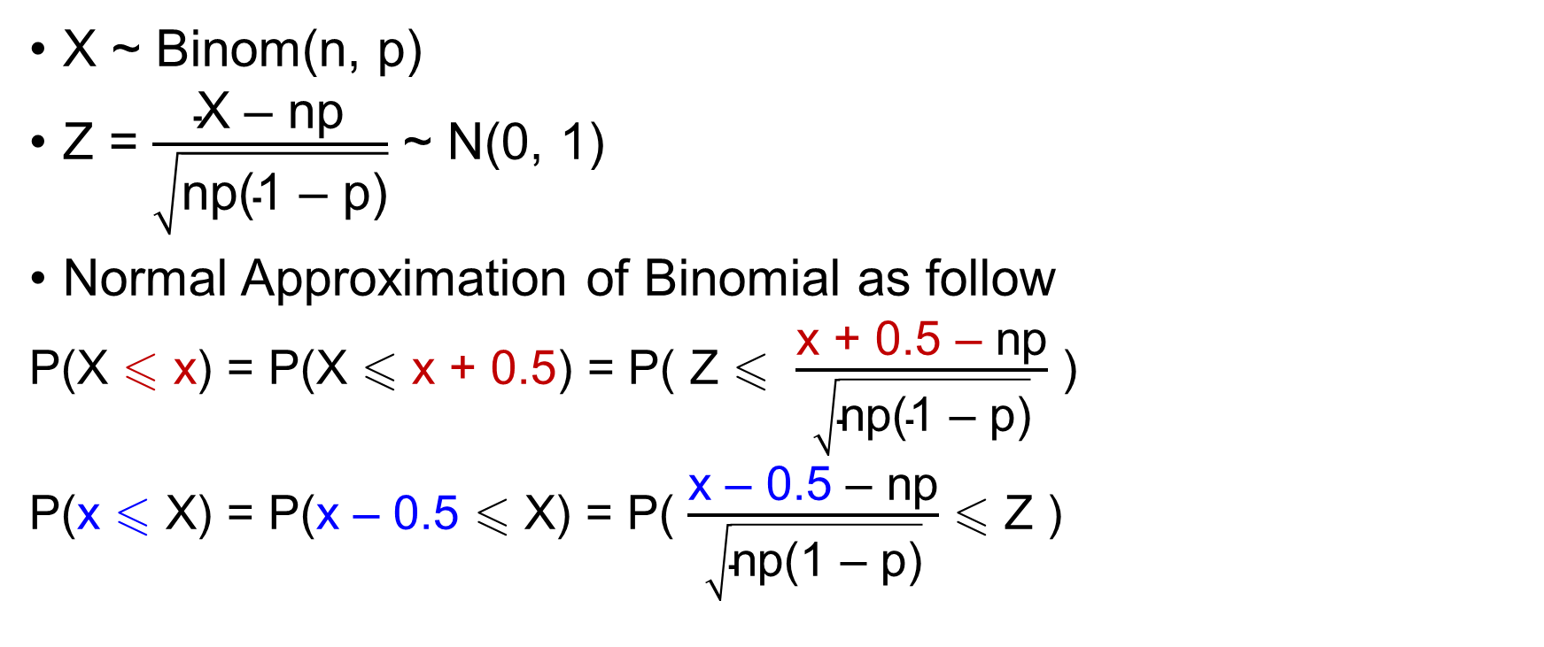
Normal Approximation to the Binomial Distribution
X ~ Binom(n, p)
Z = $\frac{\text{X}\text{ – }\text{np}}{\sqrt{\text{np}\text{(1 – }\text{p}\text{)}}}$ ~ N(0, 1)
Normal Approximation of Binomial as follow
P(X  x) = P(X  x + 0.5) = P( Z  $\frac{\text{x}\text{ + 0.5 – }\text{np}}{\sqrt{\text{np}\text{(1 – }\text{p}\text{)}}}$ )
P(x  X) = P(x – 0.5  X) = P( $\frac{\text{x} \text{–} \text{0.5 }\text{– }\text{np}}{\sqrt{\text{np}\text{(1 – }\text{p}\text{)}}}$  Z )
continuity correction
Good approximation with n and p such that
np > 5 and n(1 – p) > 5

Slide 21

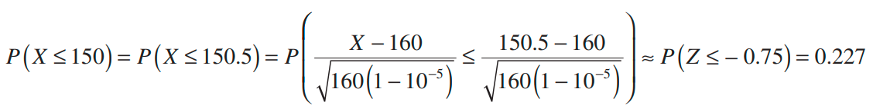
Normal Approximation to the Binomial Distribution – Ex
Assume that in a digital communication channel, the number of bits received in error can be modeled by a binomial random variable, and assume that the probability that a bit is received in error is 10⁻⁵. If 16 million bits are transmitted, what is the probability that 150 or fewer errors occur?
Let the random variable X denote the number of errors. Then X is a binomial random variable with n = 16×10⁶ and p = 10⁻⁵, and
DIFFICULT!
Use normal distribution to approximate

Slide 22
Exercise
A new computer virus attacks a folder consisting of 200 files. Each file gets damaged with probability 0.2 independently of other files. What is the probability that fewer than 50 files get damaged?

Slide 23
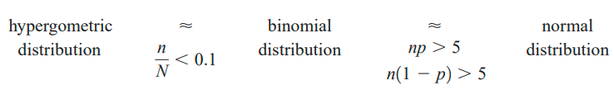
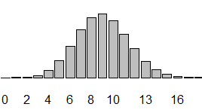
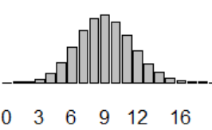
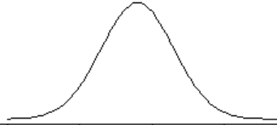


Conditions for approximating hypergeometric and binomial probabilities
N = 400, K = 120, n = 30
n = 30, p = 0.3 μ = np = 9, σ² = np(1-p) = 6.3

Slide 24
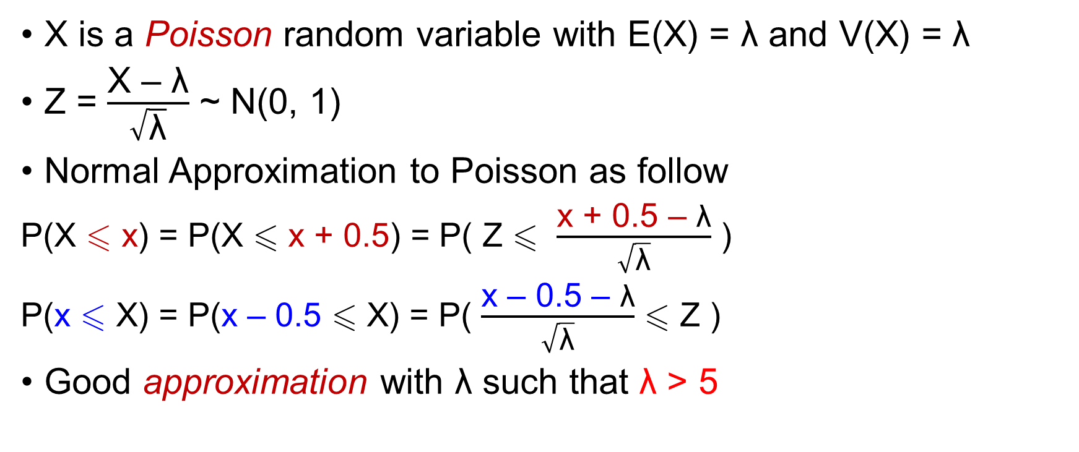
Normal Approximation to the Poisson Distribution
X is a Poisson random variable with E(X) = λ and V(X) = λ
Z = $\frac{\text{X}\text{ – }\text{λ}}{\sqrt{\text{λ}}}$ ~ N(0, 1)
Normal Approximation to Poisson as follow
P(X  x) = P(X  x + 0.5) = P( Z  $\frac{\text{x}\text{ + 0.5 – }\text{λ}}{\sqrt{\text{λ}}}$ )
P(x  X) = P(x – 0.5  X) = P( $\frac{\text{x}\text{ – 0.5 – }\text{λ}}{\sqrt{\text{λ}}}$  Z )
Good approximation with λ such that λ > 5

Slide 25

Normal Approximation to the Poisson Distribution – Ex
Ex. Assume that the number of asbestos particles in a squared meter of dust on a surface follows a Poisson distribution with a mean of 1000. If a squared meter of dust is analyzed, what is the probability that 950 or fewer particles are found?
Let X be the number of particles found. Then X ~ Pois(1000)
DIFFICULT!
AN APPROXIMATION

Slide 26
Exponential Distribution
• |  |  | • |  |  |  | • | •
X = waiting time for the next event
Consider the sequence of “rare” events, where the number of occurrences has Poisson distribution with parameter λ.
Event “the time X until the next event is greater than x” can be rephrased as “zero events occur by the time x.”
Let N be the number of events during the time interval [0, x] ➔ N~Poisson(λx).
P(X > x) = P(N = 0) = e^{-λx}(λx)⁰/0! = e^{-λx}
F(x) = P(X  x) = 1 P(X > x) = 1 – e^{-λx}
f(x) = F′(x) = λe^{-λx}

Slide 27


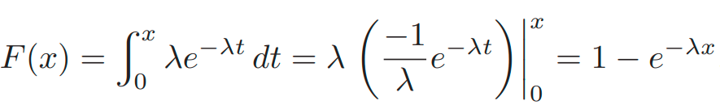
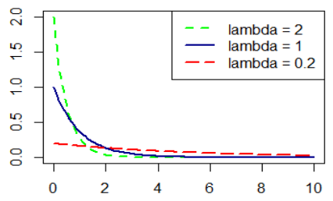

Exponential Distribution
Often used to model waiting time between rare events: time between telephone calls, accidents, etc. When the number of events is Poisson, the time between events is Exponential.
Exp.
distribution
For small lambda, it’s usual that we need a long waiting time for the next event
Notes:
In R:
dexp(x, lambda)
pexp(x, lambda)
rexp(n, lambda)
curve(dexp(x,2),0,10,ylim=c(0,2),col='green',lty=2,lwd=2)
curve(dexp(x,0.5),0,10,ylim=c(0,2),col='dark blue',lty=1,lwd=2,add=T)
curve(dexp(x,0.1),0,10,ylim=c(0,2),col='red',lty=5,lwd=2,add=T)
legend("topright", lty = c(2,1,5),lwd=c(2,2,2), text.font = 1, col= c('green','dark blue','red'),text.col = "black", legend=c("lambda = 2", "lambda = 1","lambda = 0.2"))

Slide 28
Exponential Distribution – Ex
Ex. Questions are sent to the chatbot of a Student Service at an average rate of 12 questions per day.
a/ What is the probability that the next question is sent within 1 hour ?
b/ What is the expected time between questions?
Questions arrivals represent rare events, thus the time X between them has an exponential distribution with λ = 12 (questions per day).
a/ 1hr = 1/24 day, P(X  1/24) = F(1/24) = 1 − e^{−λx} = 1 − e^{−1/2} = 0.3935
b/ E(X) = 1/λ = 1/12 (day) = 2 hours
Notes:
pexp(1/24,12)

Slide 29
Exponential Distribution – Ex
Suppose that X has an exponential distribution with a mean of 10. Determine the following:
a/ P(X < 5)
b/ P(X < 15 | X > 10)
E(X) = 1/λ = 10 ➔ λ = 1/10
a/ P(X < 5) = F(5) = 1 − e^{−5λ} = 1 − e^{−1/2} = 0.3935
b/ P(X < 15 | X > 10) = P(10 < X < 15)/P(X > 10)
= (F(15) – F(10))/(1 – F(10)) = [(1 − e^{−15λ} ) – (1 − e^{−10λ})]/e^{−10λ}
= e^{−10λ}(1 - e^{−5λ})/e^{−10λ} = 1 - e^{−5λ} = 0.3935 = P(X < 5)

Slide 30
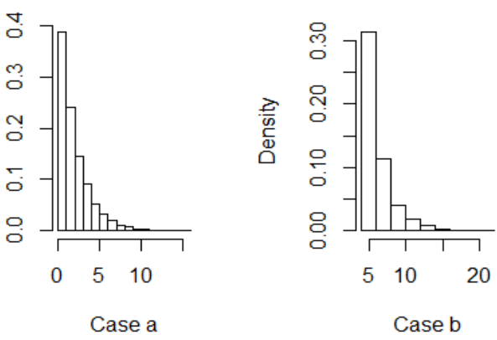
Lack of Memory Property
For an exponential random variable X,
P(X < t₁ + t₂ | X > t₁) = P(X < t₂)
Ex. The time between the arrival of electronic messages at your computer is exponentially distributed with a mean of two hours (λ = 1/2).
a/ What is the probability that you do not receive a message during a two-hour period?
P(X > 2) = 1 – P(X  2) = e^{-2λ} = e⁻¹ = 0.368
b/ If you have not had a message in the last four hours, what is the probability that you do not receive a message in the next two hours?
P(X > 6 | X > 4) = P(X > 2)
Notes:
# Lack of Memory Property
# Case A: start waiting at time t=0
# Case B: continue waiting after t=4 hours
n <- 10000
A <- rexp(n,1/2)
mess <- rexp(n,1/2)
B <-mess[mess>4]-4
mean(A)
mean(B)
par(mfrow=c(1,2))
hist(A, prob=T)
hist(B,prob=T)

Slide 31
SUMMARY
Continuous Uniform
Continuous variables can take any value of an interval in 
Continuous
r. v.
Normal
Exponential

Slide 32
Exercises
(5x + 19) mod 109
(7x + 29) mod 109
(9x + 39) mod 109

Slide 33
THANKS

